Slide 1
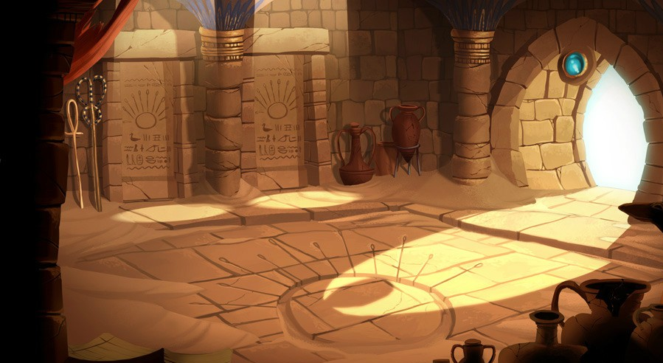
Finding Dawn
Silly Arts Games

Slide 2


Silly Arts Games
Software Engineer / Project Manager - Harshil
Graphic Designer - Pragnesh
QA Tester - Pragnesh
Artist + Sound Engineer - Dylan

Slide 3
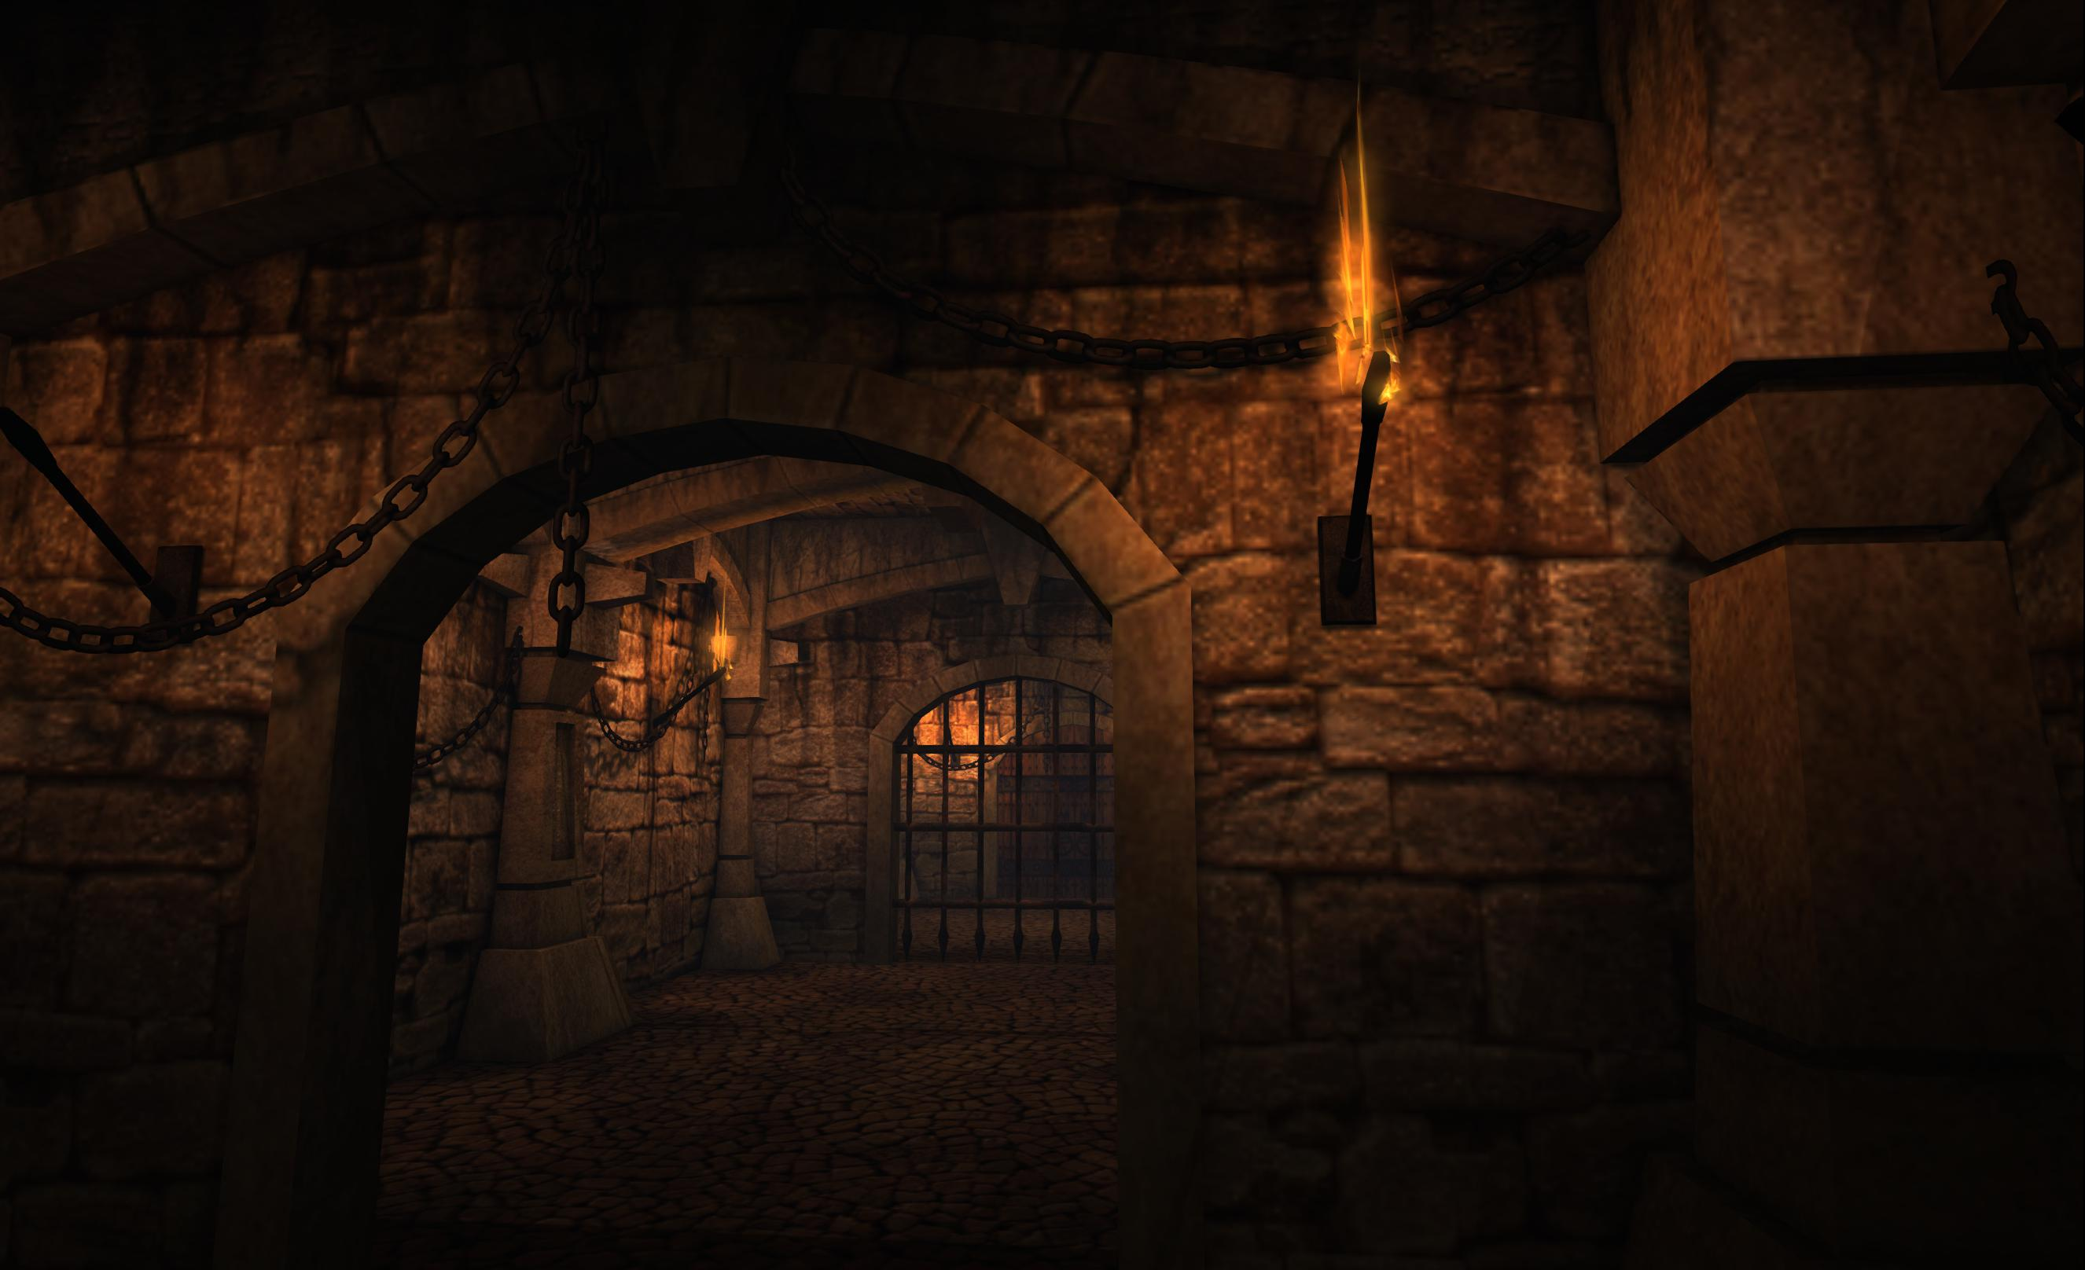
Finding Dawn
A 2D dungeon game where player has to find their way out to see the daylight after being trapped somewhere underground for long time.

Slide 4
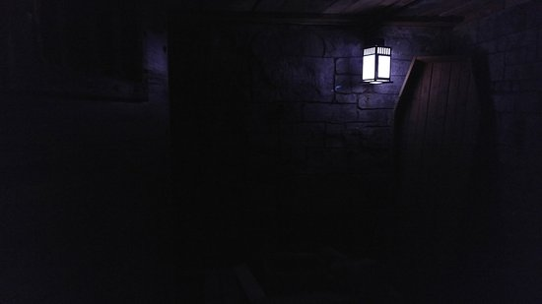
Game Planning
Daylight (Movie)
Game ideas from Prince, Dungeon Crawler, Deep Dark Dungeon

Slide 5
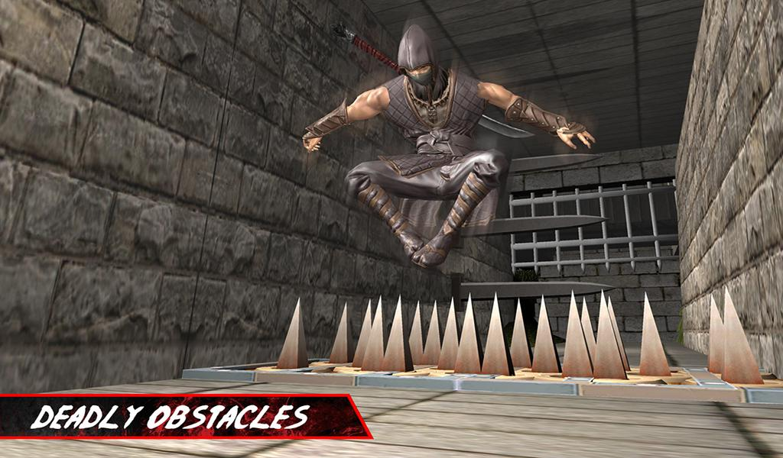
Game Atmosphere
Player start from somewhere inside dungeon
It’s single player game. Multiplayer if top-down
Players has to find way out to see the daylight within given time
Notes:
Defeat the army and leader to go to the next level and eventually defeat the alpha leader

Slide 6
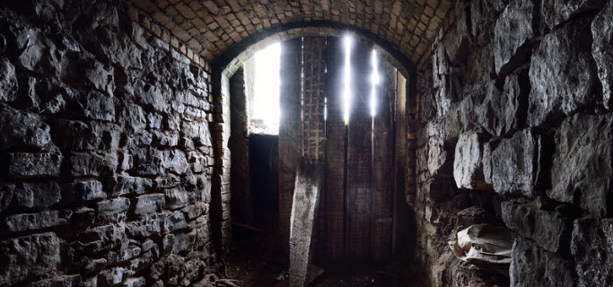
Gameplay Mechanics
Mechanics:
Moving in left-right
Use weapon to kill the opponent
Jumping – if platformer
Dynamics:
Kill enemies by shooting/knife
Jump to avoid obstracles
Find your way out through dungeon
Collect weapons on the way so use against strong enemy
Aesthetics:
Explore new dungeons
Master your keyboard skills for close combats.

Slide 7
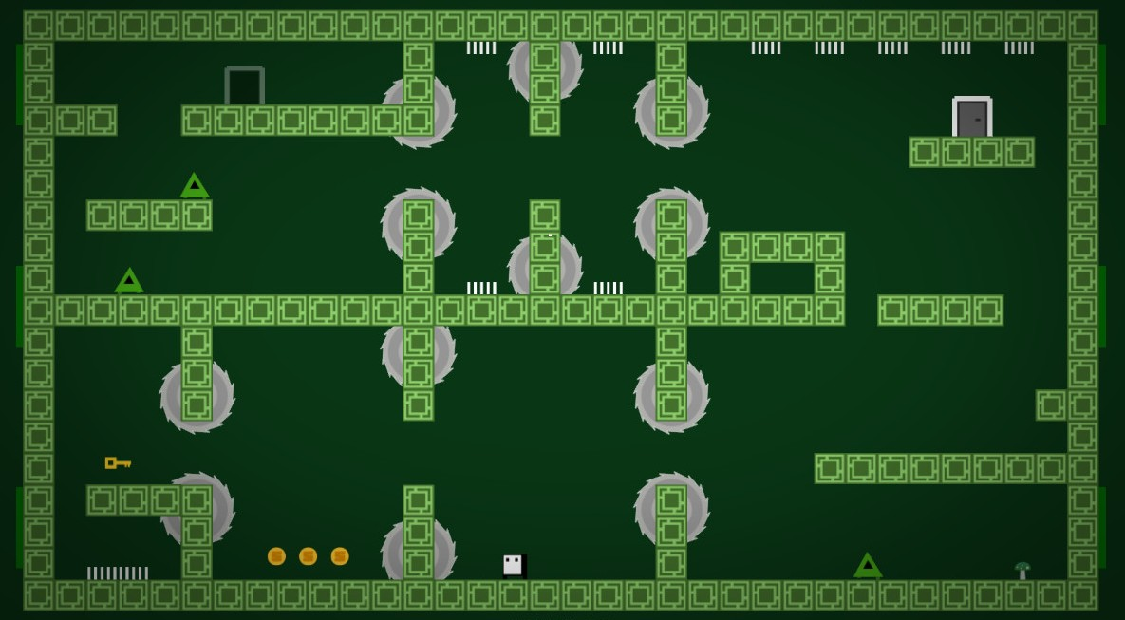
Game Elements
Destructible objects/obstacles: creepy creatures
Non Destructible objects : Spikes, Dungeon walls
Collectables:
Health, Weapons, Time Boosts
Notes:
Defeat the army and leader to go to the next level and eventually defeat the alpha leader

Slide 8
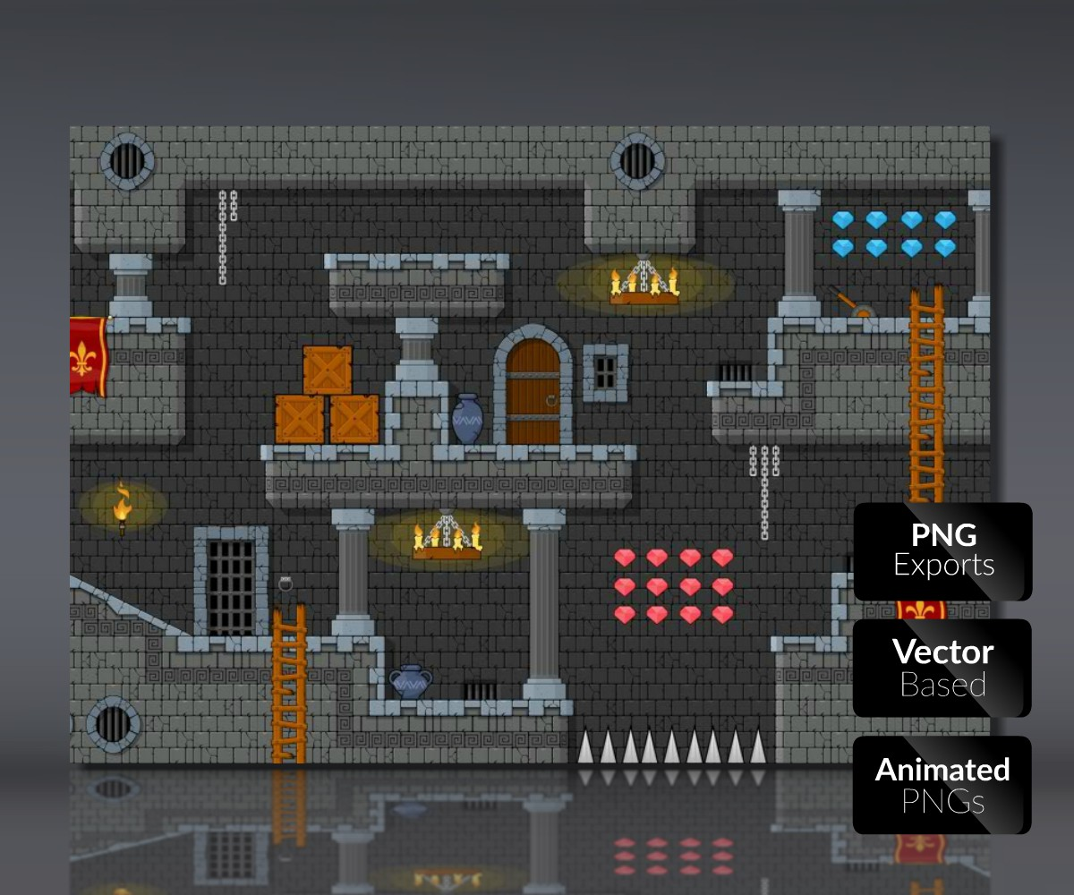
Game Preparation
Applications:
Unity, Github, Krita/Photoshop
Weekly meetings
Assign tasks every week

Slide 9

THANK YOU

